Slide 1


Evaluating Communication Costs for Distributed Sparse Tensor Factorization on Multi-GPU Systems
Thomas B. Rolinger, Tyler A. Simon,
Christopher D. Krieger
SuperComputing 2017

Slide 2
Outline
Background
Motivation & Approach
Experiments & Results
Discussion
Conclusions & Future Work

Slide 3
1.) Background: Tensors
Tensors: Multidimensional arrays
  Typically very large and sparse
  Ex: NELL-1 has 143 million NNZ and density of 10⁻¹³
Tensor Factorization:
  Higher-order extension of matrix singular value decomposition (SVD)
  CP-ALS: Alternating Least Squares
    Critical routine: Matricized tensor times Khatri-Rao product (MTTKRP)

Slide 4
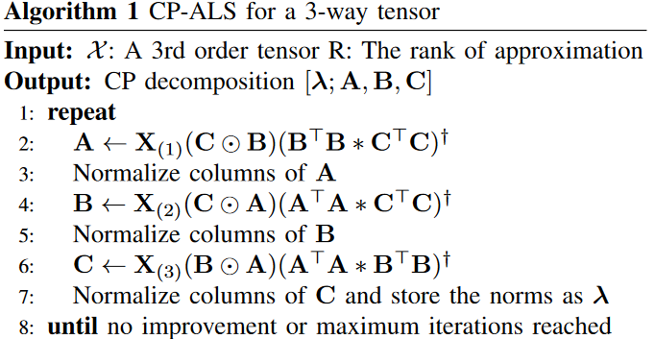
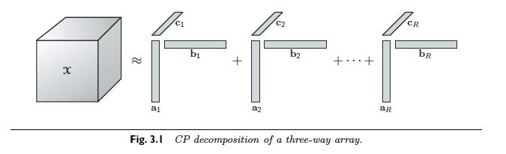
1.) Background: Tensors (cont.)
MTTKRP
X₍₁₎ : Matricized Tensor (sparse)
(C⊙B) : Khatri-Rao Product (dense)

Slide 5
1.) Background: ReFacTo
Distributed Heterogeneous CP-ALS
Extension/refactorization of existing CP-ALS algorithm
  DFacTo
Utilizes one GPU on each node for sparse matrix times vector (SpMV)

Slide 6
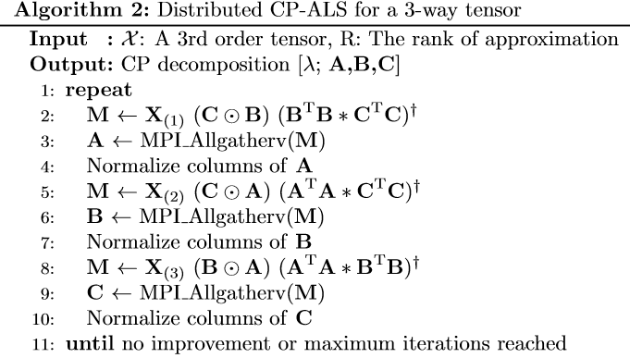
1.) Background: ReFacTo Communication
Communication required after each MTTKRP
  Each MPI rank assigned a contiguous slice of the tensor
  For each MPI rank, MTTKRP computes some number of rows of the factor matrix (lines 2, 5, 8)
  Each MPI rank sends those updated rows to all other ranks (lines 3, 6, 9)
  After communication, all MPI ranks have the same fully updated factor matrix
Collective
Irregular msg sizes
blocking

Slide 7
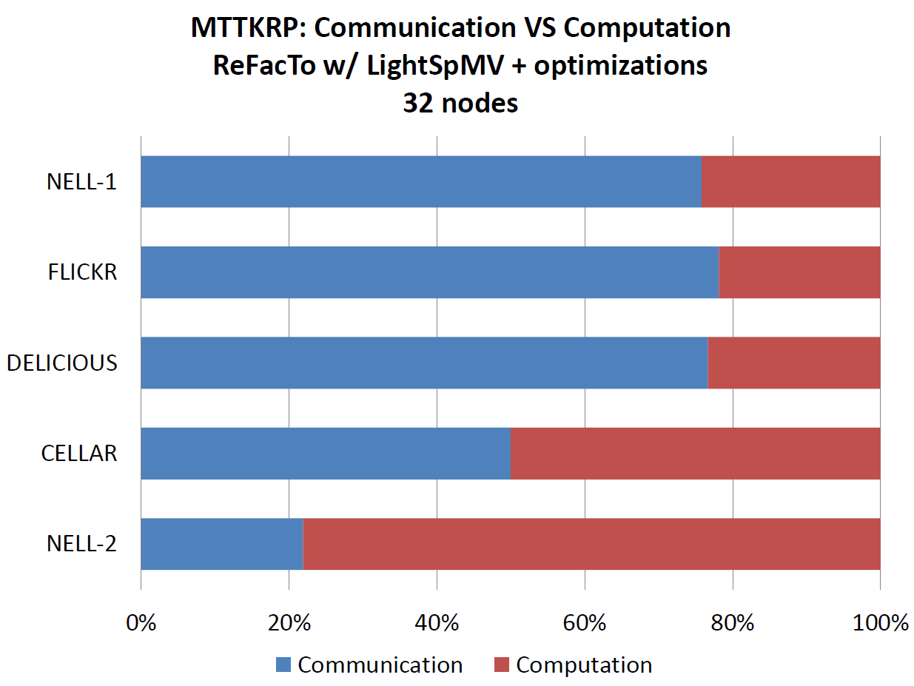
2.) Motivation: Communication vs. Computation
ReFacTo (FDR Infiniband – 32 nodes)
All-GPU routines
Communication cost dominating factor

Slide 8
2.) Approach: GPU-to-GPU Communication
Perform all computation on GPUs
  Then host only performs communication
Communication only involves data residing on the GPUs
Take advantage of specialized GPU communication software and hardware
  Software: CUDA aware MPI & NCCL
  Hardware: NVLink

Slide 9
2.) Approach: CUDA-aware MPI
Send GPU buffers via MPI w/o explicit calls to cudaMemcpy
Inter- and intra-node GPU communication
  GPUDirect Peer-to-Peer (P2P)
  GPUDirect RDMA (GDR)
No modifications required to MPI calls
Supported libraries
  OpenMPI, MVAPICH, etc.

Slide 10
2.) Approach: NCCL
NCCL: NVIDIA Collective Communications Library
Automatic topology detection
  Does not rely on availability of P2P access like CUDA-aware MPI
  Better utilization of NVLink topology
Multi-ring topology to provide maximum bandwidth
NCCL 2.0: inter-node communication support
Lacks vector routines (i.e. Allgatherv)
  Recreate with series of bcasts

Slide 11
2.) Approach: End Result
ReFacTo ported onto dense multi-GPU systems (DGX-1)
  A single node with 8 GPUs
Same code also runs on traditional clusters
  Many nodes with 1 GPU per node
Can use CUDA-aware MPI or NCCL for communication on either system

Slide 12
3.) Experiment: Goal and Setup
Goal: Evaluate communication performance for ReFacTo on 2 different systems using different communication libraries
Systems:
  DGX-1: 8x P100 connected via NVLink
  Cluster: 32 nodes connected by FDR Infiniband with one K40m per node
Communication Libraries:
  OpenMPI 2.1.1 with and without CUDA support
    GDR not enabled due to hardware limitations on cluster
  NCCL 2.0.4
    Also does not utilize GDR on cluster for same reasons

Slide 13
3.) Experiment: Performance Metric
Metric: Total communication time
Time require to get updated data from each GPU to all other GPUs
MPI:
  DtoH + MPI_Allgatherv + HtoD
CUDA-MPI:
  MPI_Allgatherv
NCCL:
  ncclBcast calls

Slide 14
3.) Experiment: Cluster
K40m
K40m
K40m
.......
.......
.......
Unidirectional Bandwidth
node01
node02
node32
.......
PCIe x16 3.0 (16 GB/s)
Infiniband FDR (7 GB/s)
Infiniband Switch

Slide 15
3.) Experiment: DGX-1
CPU
CPU
PCIe Switch
PCIe Switch
PCIe Switch
PCIe Switch
P100
P100
P100
P100
P100
P100
P100
P100
Unidirectional Bandwidth
PCIe x16 3.0 (16 GB/s)
QPI (19.2 GB/s)
NVLink (20 GB/s)

Slide 16
3.) Experiment: Datasets
Name | NNZ | Avg Msg Size |  | Min/Max Msg Size
 |  | 2 GPUs | 8 GPUs | 2 GPUs | 8 GPUs
NELL-2 | 77M | 1.11MB | 0.28MB | 0.6MB / 1.9MB | 0.1MB / 0.5MB
CELLAR | 20M | 12.1MB | 3.02MB | 2.3MB / 24.5MB | 0.6MB / 6.3MB
DELICIOUS | 140M | 128.91MB | 32.23MB | 0.2MB / 496MB | 0.006MB / 152MB
FLICKR | 112M | 382.49MB | 95.62MB | 0.47MB / 859MB | 0.02MB / 214MB
NELL-1 | 143M | N/A | 140.78MB | N/A | 28MB / 354MB

Slide 17

3.) Results: Cluster
Cluster :
  NCCL generally the fastest
  NCCL slower than MPI approaches on small tensors
  On large tensors, NCCL up to 2x faster than MPI and 1.5x faster than MPI-CUDA

Slide 18
3.) Results: DGX-1
DGX-1:
  MPI-CUDA 3.2x faster on average than MPI
  NCCL 5.3x faster on average than MPI and 1.65x faster than MPI-CUDA
  NCCL up to 10.9x faster than MPI, leading to a 64% reduction in overall CP-ALS runtime

Slide 19
4.) Discussion: Overall
In general, DGX-1 provides better overall performance when compared to cluster for all communication libraries
  Exception: non-CUDA MPI is faster on cluster for large tensors when using 8 GPUs when compared to DGX-1
Considerations for CP-ALS on multi-GPU systems
  Tensor properties
  GPU topology

Slide 20
4.) Discussion: Tensor Properties
Size of factor matrices determined by length of the tensor’s modes and CPD rank
  Higher rank CPD gives a more fine-grained factorization but results in larger factor matrices
  Larger factor matrices →larger message sizes
NCCL performs increasingly better than MPI on tensors with large factor matrices
  MPI: optimized for latency, small messages and scales out to thousands of compute nodes
  NCCL: optimized for bandwidth, large messages and targets dense multi-GPU systems (i.e. DGX-1)
  MPI-CUDA: approaches similar to NCCL, hence more comparable performance

Slide 21
4.) Discussion: GPU Topology
Single node/many GPUs vs. Many nodes/single GPU
  DGX-1: dense multi-GPU system, optimized for collective communication (hybrid mesh, NVLink)
  Cluster: single GPU per node, only path between any 2 GPUs is through host+Infiniband
On the cluster, NCCL and MPI/MPI-CUDA use the same communication paths
  NCCL only has advantage on large tensors due to bandwidth optimizations

Slide 22
4.) Discussion: GPU Topology (cont.)
On DGX-1, NCCL has advantage due to NVLink and its topology
MPI/MPI-CUDA must rely on PCIe topology
  Poor performance when using all 8 GPUs on DGX-1 since 2 GPUs share a single PCIe switch
  Less impact on cluster since each GPU has its own PCIe switch

Slide 23
5.) Conclusions
Distributed multi-GPU tensor factorization
  Run on variety of multi-GPU architectures
Performance study
  CP-ALS communication performance on DGX-1 and traditional cluster using NCCL, MPI and CUDA-aware MPI
  Communication time reduced by as much as 10.9x when using NCCL on DGX-1, leading to 64% reduction in CP-ALS runtime
Considerations
  Tensor properties
  GPU topology

Slide 24
5.) Future Work
Evaluate GPUDirect RDMA (GDR) for both NCCL and CUDA-aware MPI
Run on clusters that have multiple GPUs per node and different topologies
Expand study to other irregular applications

Slide 25
References
Jukka Antikainen, Jiri Havel, Radovan Josth, Adam Herout, Pavel Zemcik, and Markku Hauta-Kasari. 2011. Nonnegative Tensor Factorization Accelerated
Using GPGPU. IEEE Trans. Parallel Distrib. Syst. 22, 7 (July 2011), 1135–1141. https://doi.org/10.1109/TPDS.2010.194
M. Baskaran, B. Meister, N. Vasilache, and R. Lethin. 2012. Efficient and scalable computations with sparse tensors. In High Performance Extreme Computing (HPEC), 2012 IEEE Conference on. 1–6. https://doi.org/10.1109/ HPEC.2012.6408676
Joon Hee Choi and S. Vishwanathan. 2014. DFacTo: Distributed Factorization of Tensors. In Advances in Neural Information Processing Systems 27, Z. Ghahramani, M. Welling, C. Cortes, N. D. Lawrence, and K. Q. Weinberger (Eds.). Curran Associates, Inc., 1296–1304. http://papers.nips.cc/paper/5395-dfacto-distributedfactorization-of-tensors.pdf
Sylvain Jeaugey. 2017. NCCL 2.0. http://on-demand.gputechconf .com/gtc/2017/ presentation/s7155-jeaugey-nccl.pdf. (2017). Accessed: 2017-08-18.
Tamara G. Kolda and Brett W. Bader. 2009. Tensor Decompositions and Applications. SIAM Rev. 51, 3, 455–500. https://doi.org/10.1137/07070111X
J. Li, Y. Ma, C. Yan, and R. Vuduc. 2016. Optimizing Sparse Tensor Times Matrix on Multi-core and Many-Core Architectures. In 2016 6th Workshop on Irregular Applications: Architecture and Algorithms (IA3). 26–33. https://doi.org/10.1109/IA3.2016.010
Bangtian Liu, Chengyao Wen, Anand D. Sarwate, and Maryam Mehri Dehnavi. 2017. A Unified Optimization Approach for Sparse Tensor Operations on GPUs. In Proceedings of IEEE Cluster 2017, Hawaii, USA, September 5th - 8th, 2017.
Yongchao Liu and Bertil Schmidt. 2017. LightSpMV: Faster CUDA-Compatible Sparse Matrix-Vector Multiplication Using Compressed Sparse Rows. Journal of Signal Processing Systems (10 Jan 2017). https://doi.org/10.1007/s11265-016-1216-4
Thomas B. Rolinger, Tyler A. Simon, and Christopher D. Krieger. 2016. Performance evaluation of parallel sparse tensor decomposition implementations. In Proceedings of the Sixth Workshop on Irregular Applications: Architectures and Algorithms. IEEE Press, 54–57.
Thomas B. Rolinger, Tyler A. Simon, and Christopher D. Krieger. 2017. Performance Challenges for Heterogeneous Distributed Tensor Decompositions. In 2017 IEEE High Performance Extreme Computing Conference, HPEC 2017,Waltham, MA, USA, September 12-14, 2017.
Thomas B. Rolinger, Tyler A. Simon, and Christopher D. Krieger. 2017. Performance Considerations for Scalable Parallel Tensor Decomposition. J. Parallel and Distrib. Comput. (2017).
Shaden Smith and George Karypis. 2015. Tensor-Matrix Products with a Compressed Sparse Tensor. Proceedings of the 5th Workshop on Irregular Applications: Architectures and Algorithms (2015).
Shaden Smith and George Karypis. 2016. A Medium-Grained Algorithm for Distributed Sparse Tensor Factorization. 30th IEEE International Parallel & Distributed Processing Symposium (2016).
Shaden Smith, Niranjay Ravindran, Nicholas D Sidiropoulos, and George Karypis. 2015. SPLATT: Efficient and Parallel sparse tensor-matrix multiplication. 29th IEEE International Parallel & Distributed Processing Symposium (2015).
Benyou Zou, Cuiping Li, Liwen Tan, and Hong Chen. 2015. GPUTENSOR. Inf. Sci. 299, C (April 2015), 159–177. https://doi.org/10.1016/j.ins.2014.12.004

Slide 26
Questions
Contact: tbrolin@cs.umd.edu

Slide 28
Back up Slides

Slide 29
System: Cluster
System: 32 node cluster with (per node):
  Memory: 512GB DDR4
  CPU: Two 10-core E5-2650v3 Xeon Haswell
    2.3GHz
    25MB shared last level cache
    AVX 2.0
  GPU: NVIDIA Tesla K40m
    12GB global memory
    48KB shared memory per SM
    288 GB/sec max BW
    4.29 TFLOPS (single-precision)

Slide 30
Applications and Build Details
32-bit integers and single-precision floats
Compiler: nvcc/g++
MPI: OpenMPI 2.1.1
NCCL: 2.0.4
CUDA: 8.0

Slide 31
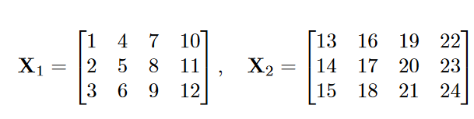
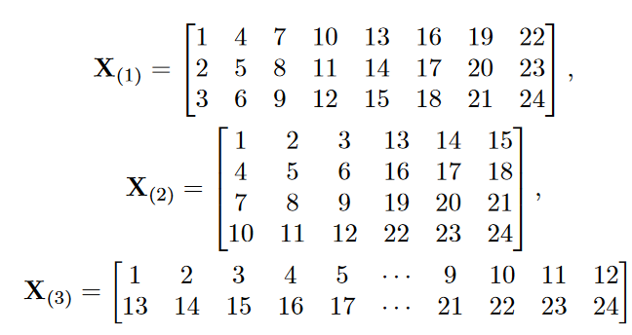
Matricizing a Tensor

Slide 32
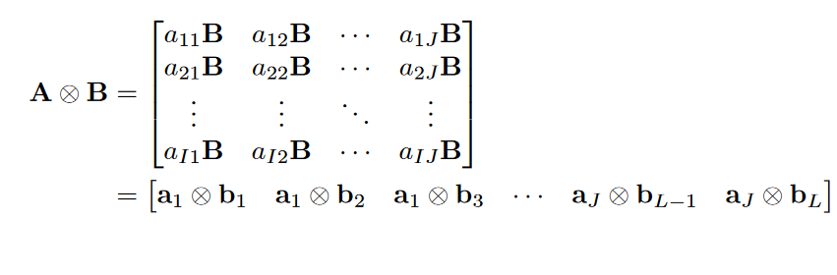

Kronecker and Khatri-Rao Prodcuts
Kronecker Product
Khatri-Rao Product

Slide 33
Background: ReFacTo Communication
Communication required after each MTTKRP
  Each MPI rank assigned a contiguous slice of the tensor
  For each MPI rank, MTTKRP computes some number of rows of the factor matrix (lines 2, 5, 8)
  Each MPI rank sends those updated rows to all other ranks (lines 3, 6, 9)
  After communication, all MPI ranks have the same fully updated factor matrix

Slide 34
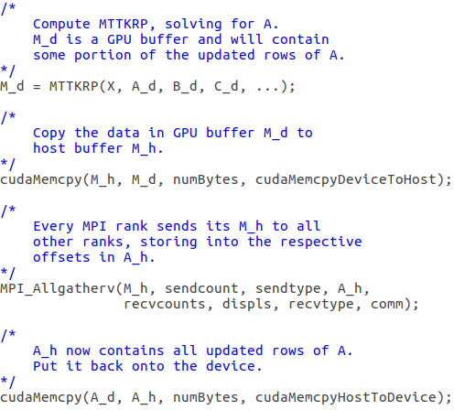
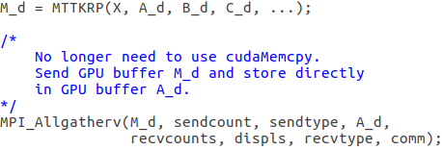
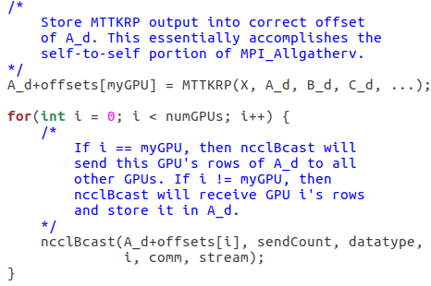
Approach: Communication Code
MPI (original) ReFacTo)
CUDA-aware MPI
NCCL

