Slide 1
Regional Software Defined Science DMZ
(SD-SDMZ)
Supercomputing 2017
November 12-17, 2017
Denver, Colorado
Tom Lehman
Director of Research
UMD/MAX
Xi Yang
Senior Research Scientist
UMD/MAX

Slide 2
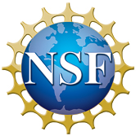


Team and Research Projects
UMD/MAX Team
  Tom Lehman
  Xi Yang
  Alberto Jimenez
  Multiple Students
Results from several research projects including:
  High Performance Computing with Data and Networking Acceleration (HPCDNA)
  Resource Aware Intelligent Network Services(RAINS)
  GENI Enabled Software Defined Exchange (SDX)

Slide 3
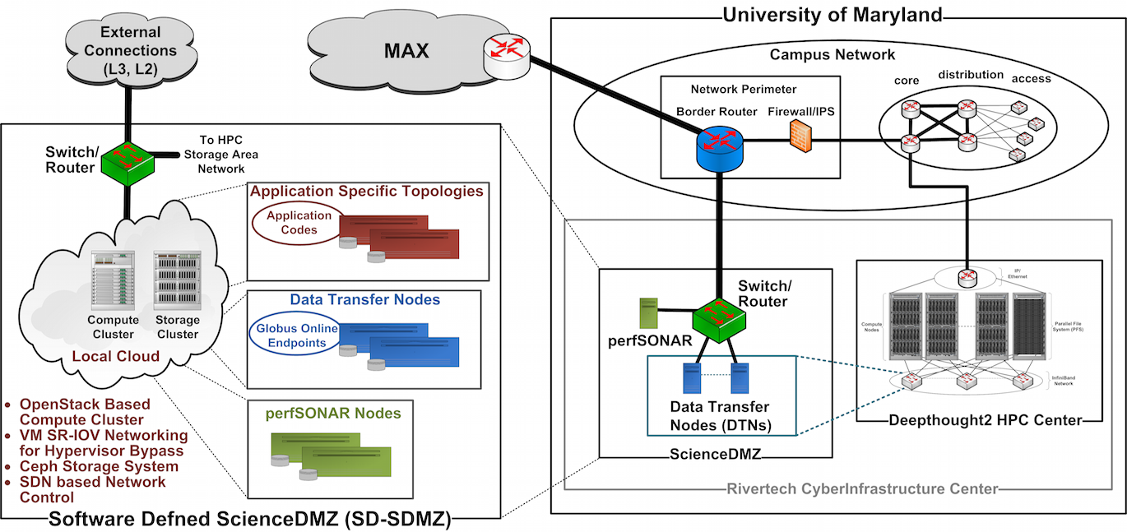
Software Defined Science DMZ
Traditional SDMZ: Bare metal Data Transfer Nodes (DTNs, perfSONAR nodes, manual switch/router control
SD-SDMZ: Local Compute Cluster, OpenStack, Ceph, SDN Network Control. On Demand, scalable, traditional services and advanced hybrid cloud services

Slide 4
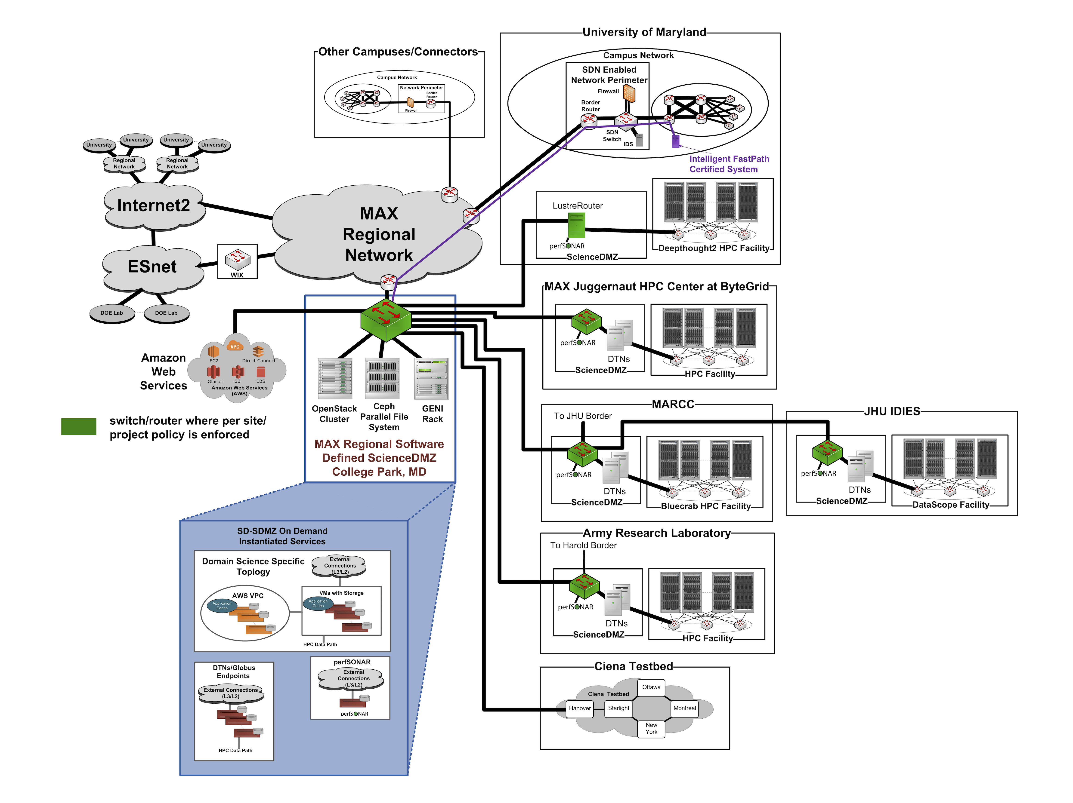
Regional Based Software Defined ScienceDMZ
Regional resource serving the MAX participant community
Built upon technologies similar to those used in modern data centers this "cloudified SDMZ" provides a scalable, multi-tenancy environment
Embedding this resource in regional network allows the SD-SDMZ to leverage rich connectivity to advance cyberinfrastructure to provide new and flexible services.

Slide 5
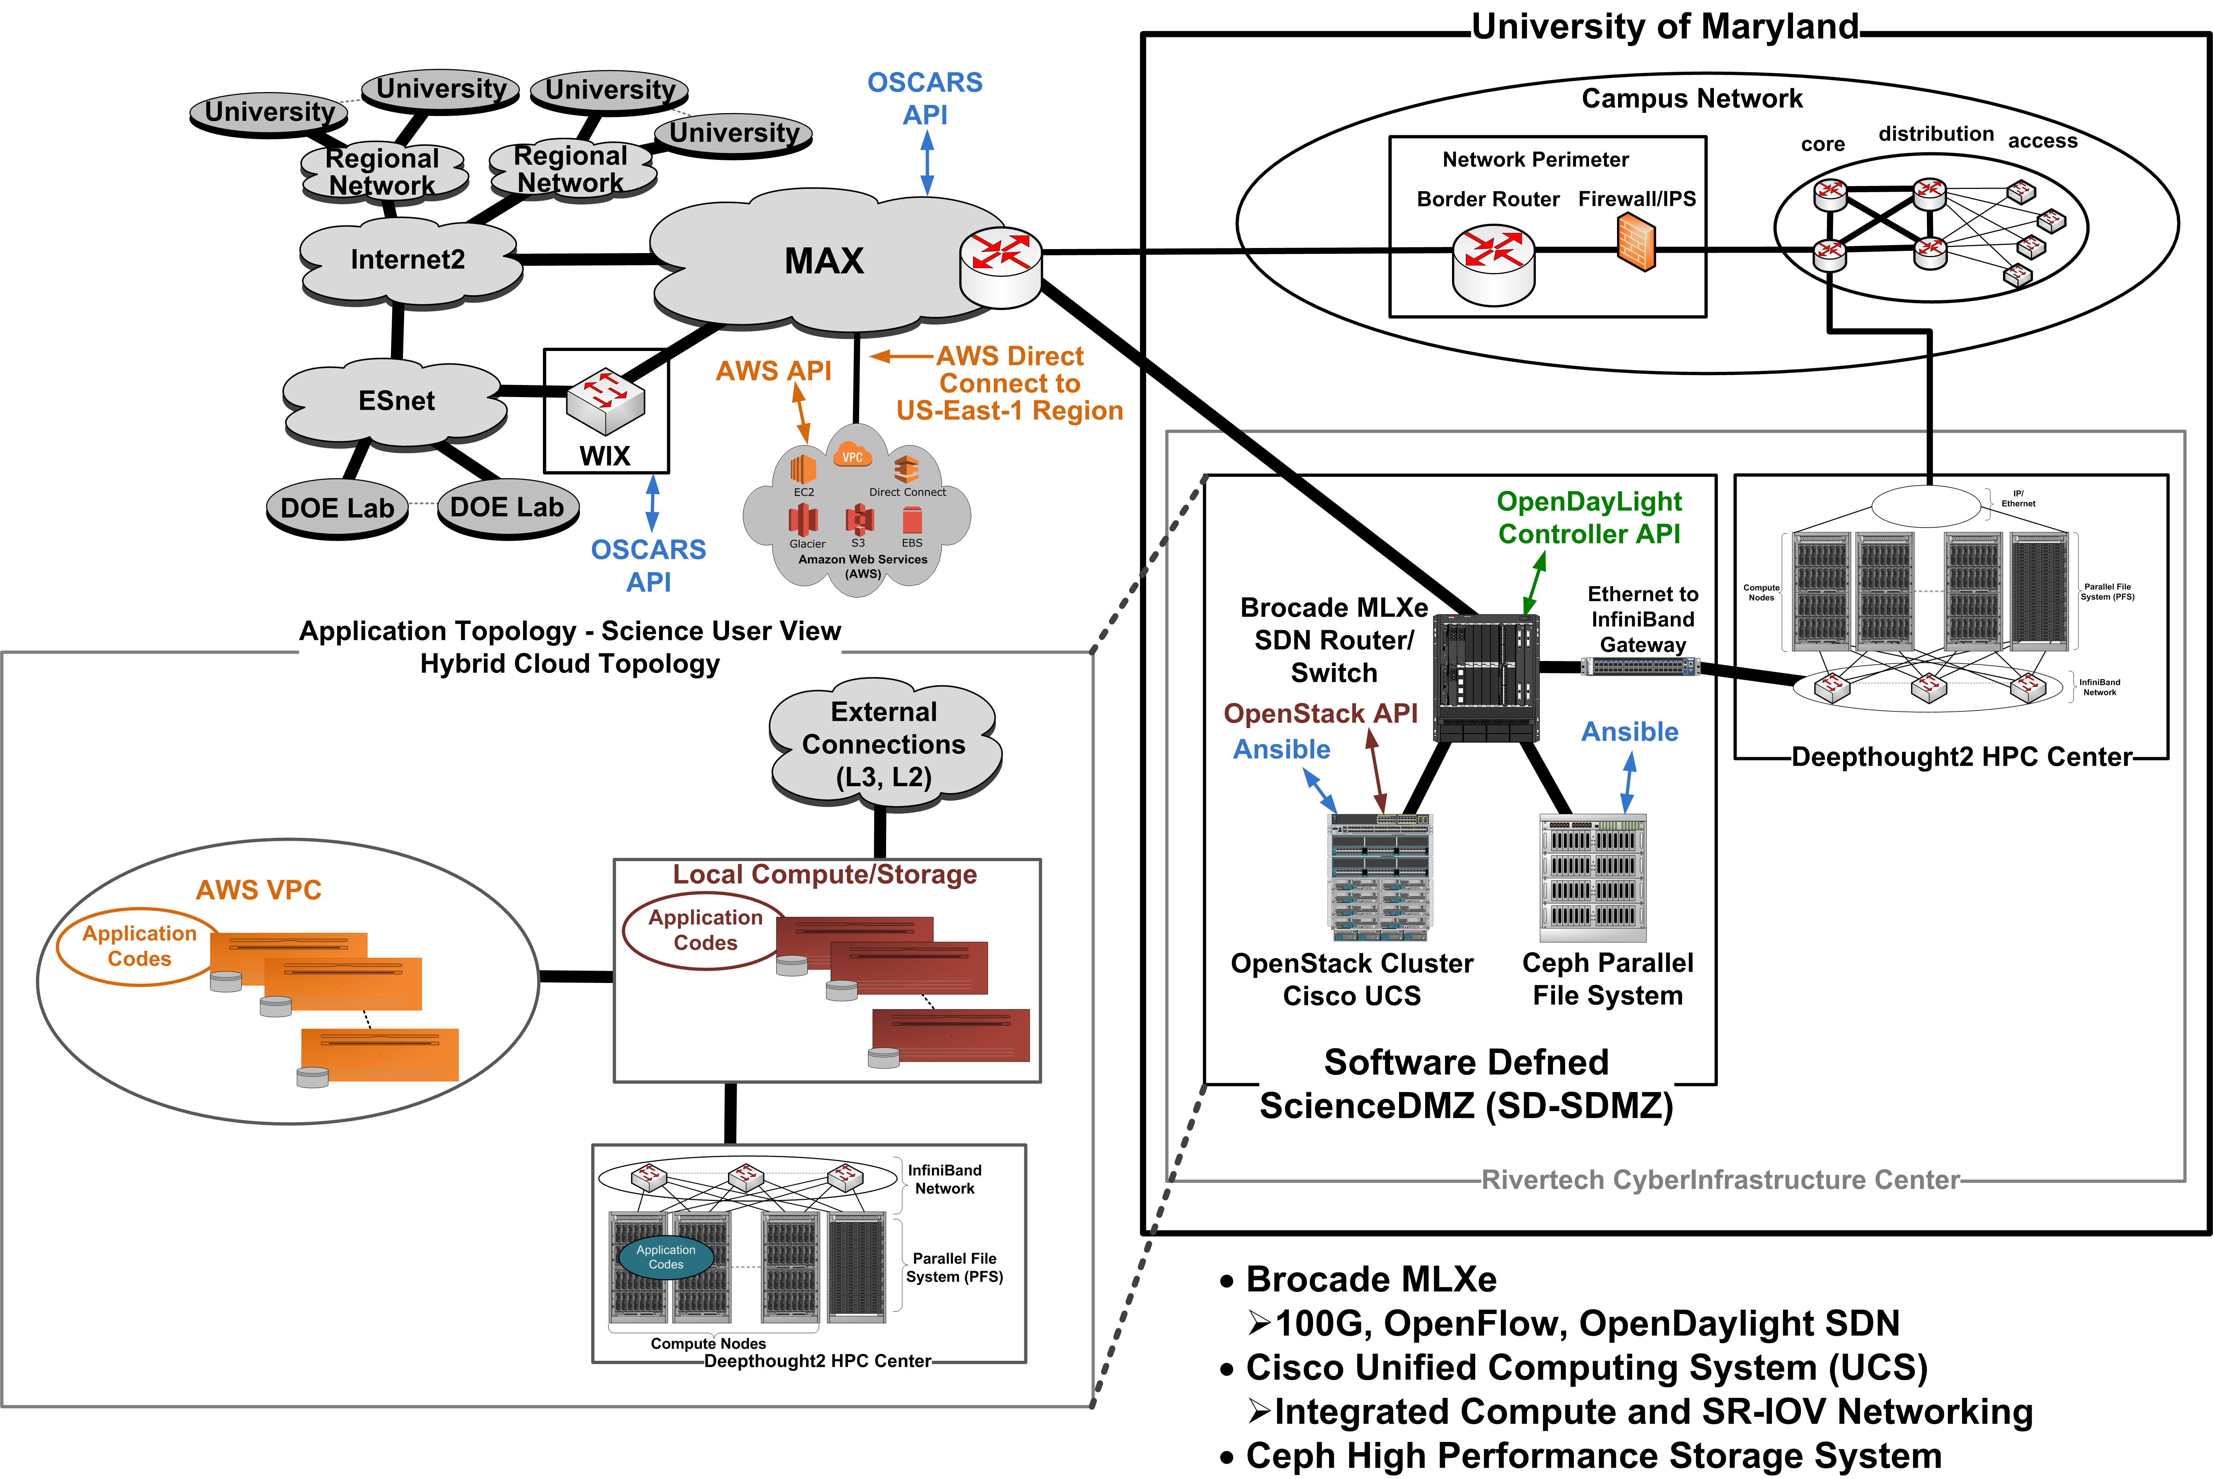
UMD SD-SDMZ

Slide 6
SD-SDMZ Services
Advanced Hybrid Cloud (AHC) Service
On Demand, Application Specific, Hybrid Topologies which include one of more of the following:
Local OpenStack Virtual Machines (with SRIOV interfaces to network and storage)
Dedicated Local Ceph Storage Resources and Connections
Integrated AWS Resources (Virtual Private Cloud (VPC) or Public)
  User controlled AWS resources, or
  SD-SDMZ facility provided AWS resources (EC2, Storage, S3 endpoints)
Network Connections
  AWS Direct Connect integration for access to AWS Public or VPC resources
  Layer2/Layer2 External Connections across Internet2, ESnet, others
  Customized topology templates for individual user requirements
Future:
  Service connections/integration with other public cloud infrastructures
  Service connections/integration with other R&E cloud, HPC, data repositories, etc.
  Schedulable Services

Slide 7
SD-SDMZ Services
Data Transfer Node (DTN) Service
SDMZ DTN service for data movement to/from HPC and other systems
Built using AHC Service (Local OpenStack Virtual Machines with SRIOV interfaces to network and Ceph storage)
Globus Endpoints
Dataplane integration with HPC file systems (via IB/Ethernet Gateway)
HPC System compute nodes mount SD-SDMZ CephFS
On-Demand Scalable DTN infrastructure (dedicated DTN nodes on a per project or user basis available)

Slide 8

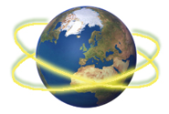
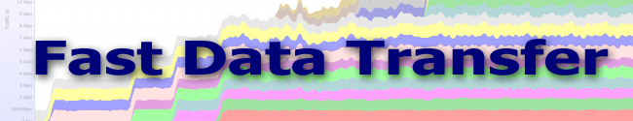

SD-SDMZ Services
Data Movement Systems
Globus Data Transfer
  https://www.globus.org/data-transfer
Fast Data Transfer (FDT)
  https://github.com/fast-data-transfer/fdt
Aspera
  http://asperasoft.com

Slide 9
Our Approach and Solution
Multi-Resource Orchestration: integrating and orchestrating the network and network services with the things that attach to the network – compute, storage, clouds, and instruments.
Model Driven: using models to describe resources in order to allow integrated reasoning, abstraction, and user centered services
Intelligent Computation Services: Model driven, multi-resource computation services to enable orchestration services in response to high level user requests.
We want to “Orchestrate the Automaters”

Slide 10
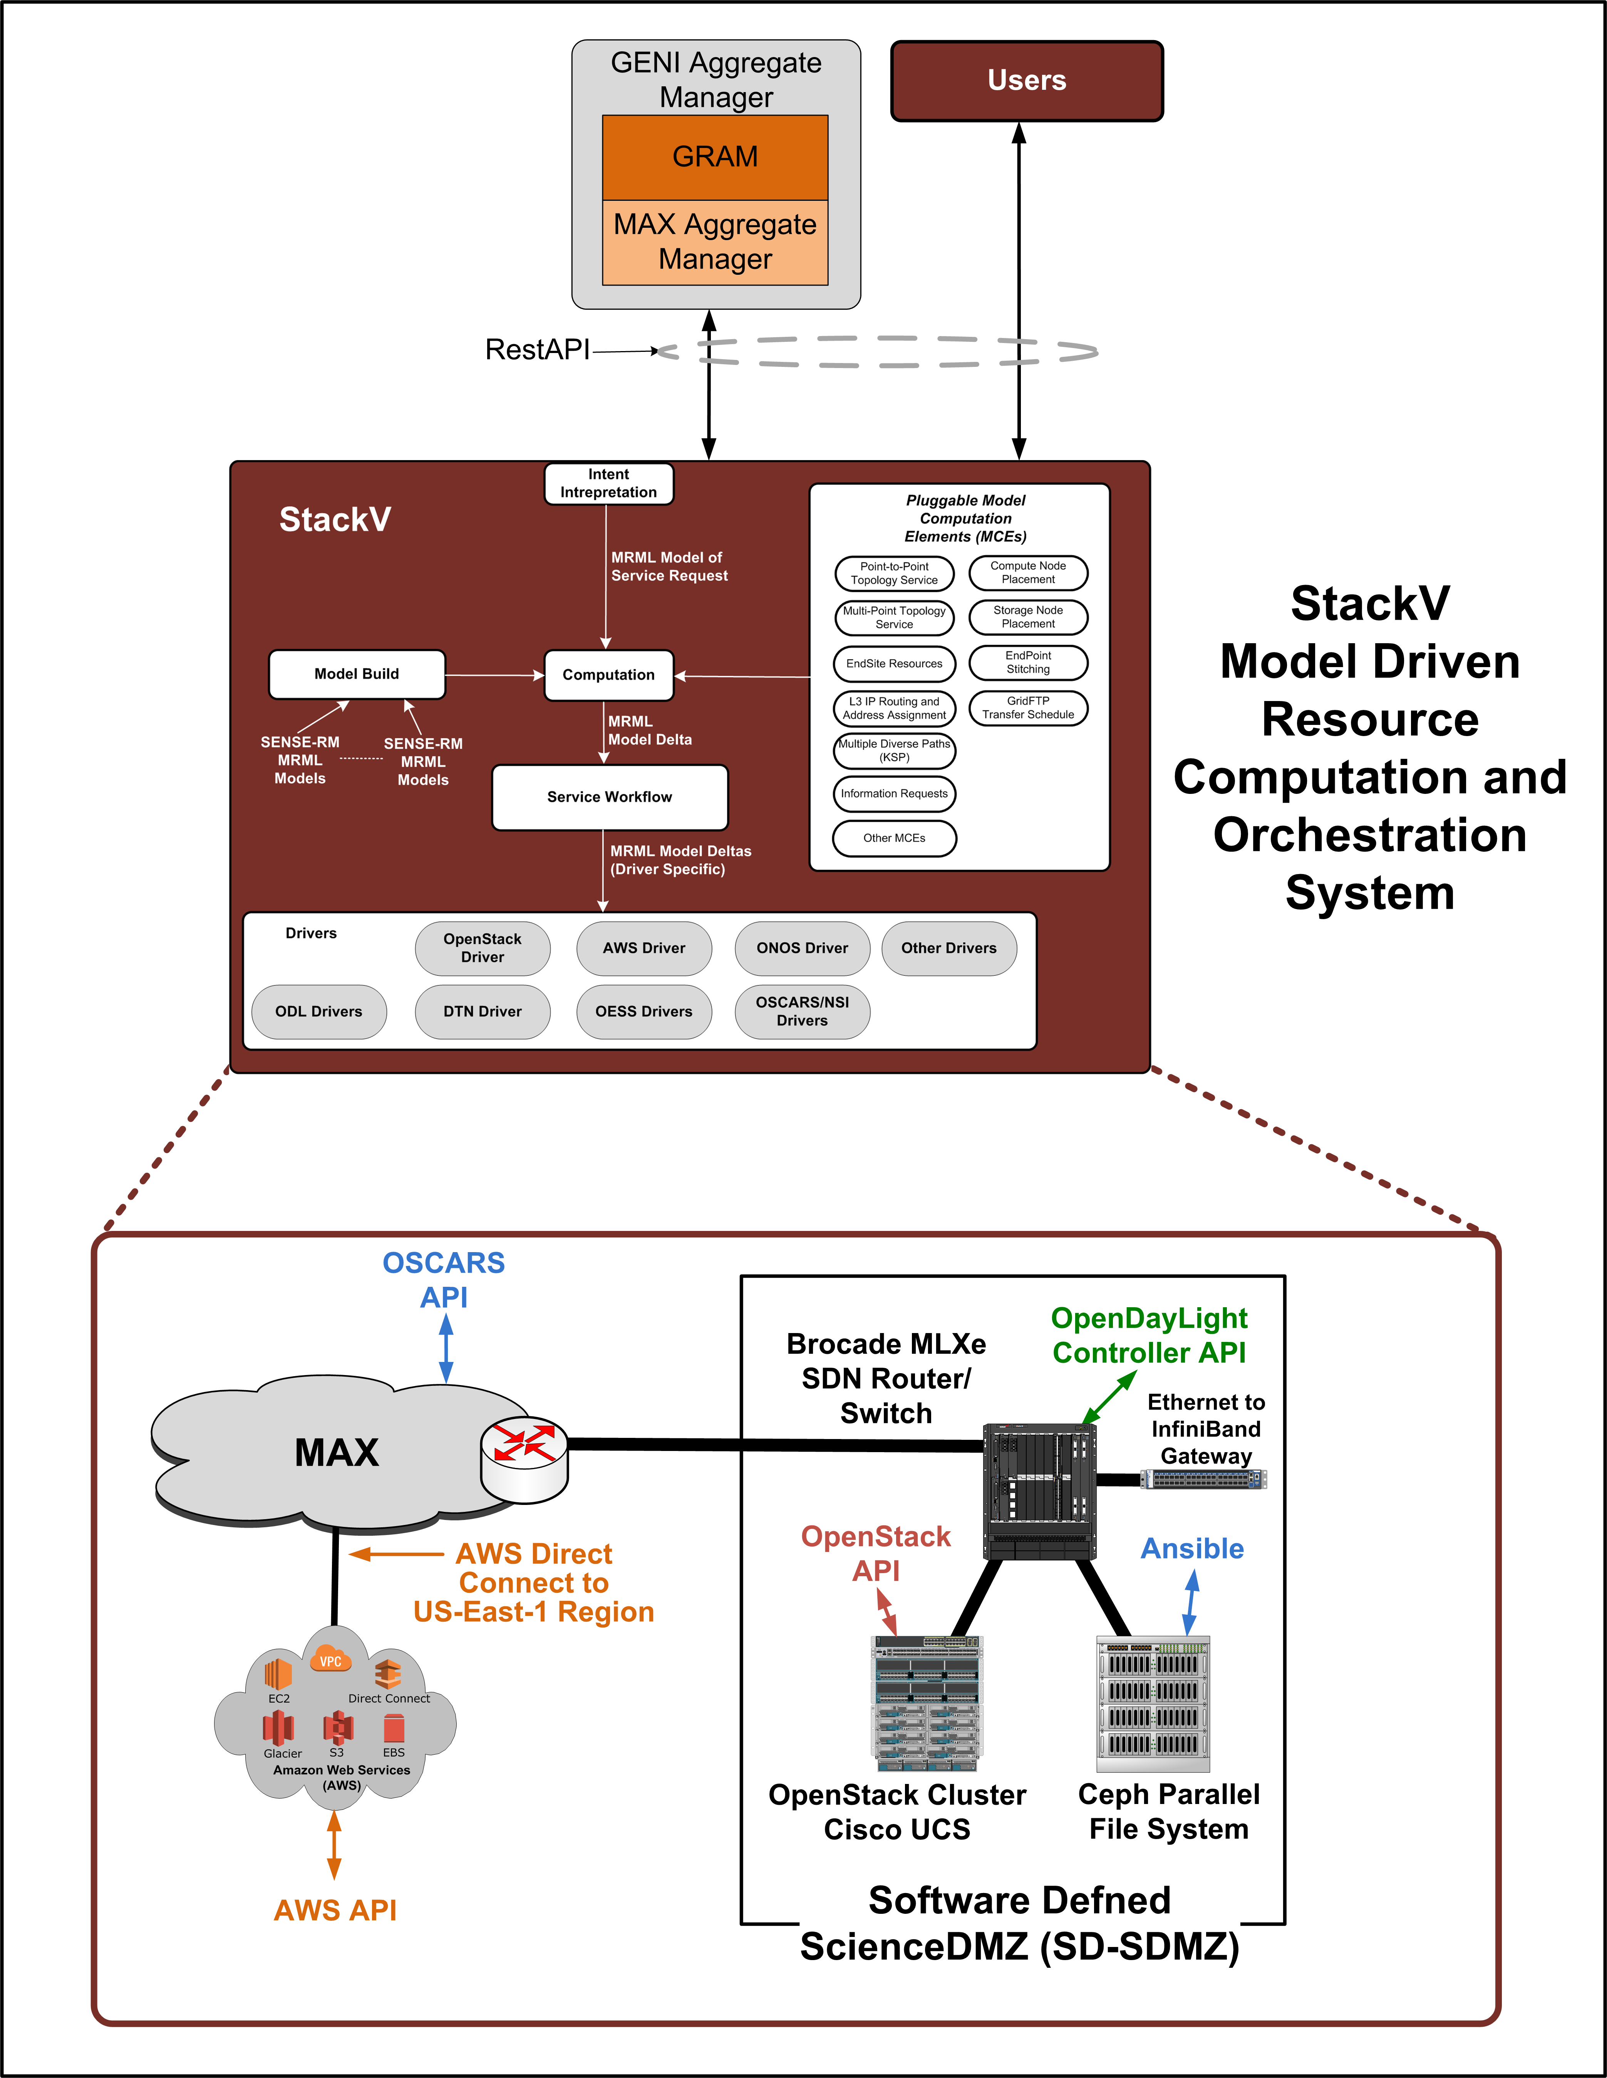
SD-Science DMZ Hardware/Software
Brocade MLXe:
OpenFlow 1.3 Capable
8x100G Ports
4x40G Ports
24x10G Ports
48x1G Ports
Cisco Unified Computing System (UCS):
12 Compute Blades, dual socket, multi-core
2x2 redundant Fabric Interconnects with FEX technology
2x3548 Nexus OpenFlow capable switch
running OpenStack Liberty
Ceph (luminous)/Ethernet High Performance File System:
6 Object Storage Devices at 36 TB each (12x3TB drives)
Approximately 200 Terabytes high performance cache storage
Each OSD chassis
  2U Chassis, 2 Intel Xeon E5-2609 Quad-Core, 2.4Ghz CPUs
  8GB Memory
  LSI MegaRaid 9280-16i4 SAS, 6GB/s PCI-e RAID Card
  Dual Port 10Gbe NIC card
  12 3 Tbyte SATA 6GB/s Hard Drives

Slide 11
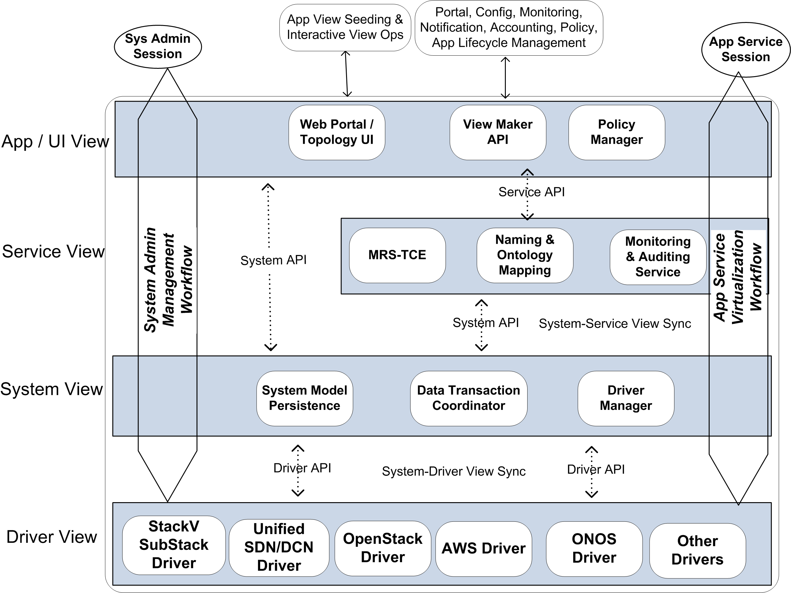
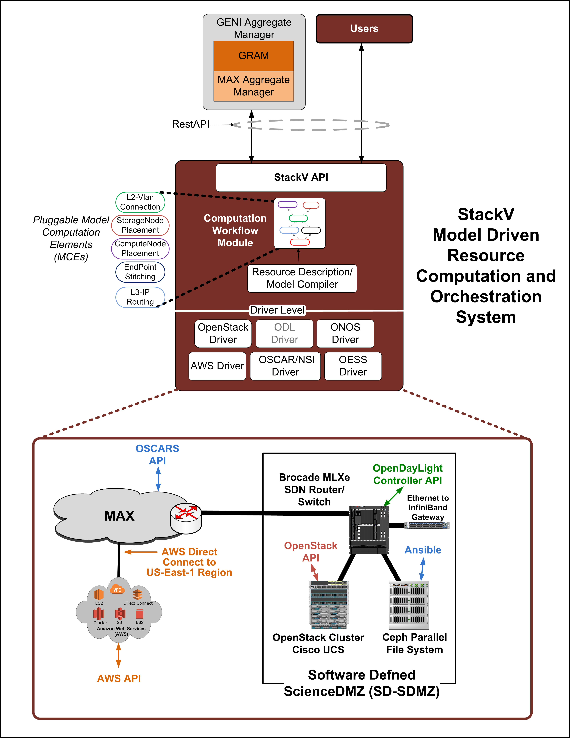
StackV Software
Architecture
Conceptual View
UMD/MAX developed StackV is an open source model driven orchestration system:
  github.com/MAX-UMD/stackV.community
Native StackV Application (Northbound) API
Access via GENI Aggregate Manager API
Multiple Drivers, Southbound APIs

Slide 12
Model Driven Orchestration
Modeling schemas based on OGF Network Markup Language (NML).
Developed extensions to allow resources which are connected to the network to also be modeled: Multi-Resource Markup Language (MRML)
  https://github.com/MAX-UMD/nml-mrml
Utilizes Resource Description Framework (RDF) and OWL 2 Web Ontology Language W3C Specifications

Slide 13
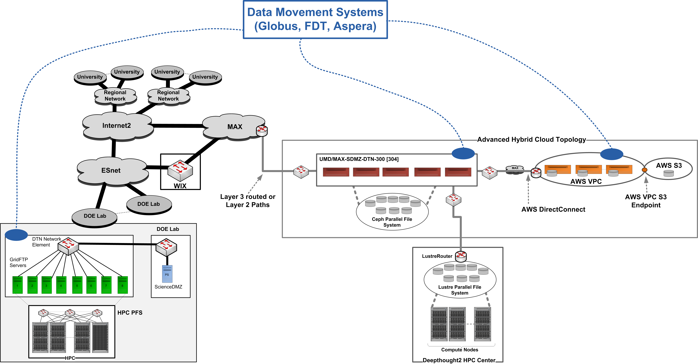
SD-SDMZ Demonstration

Slide 14
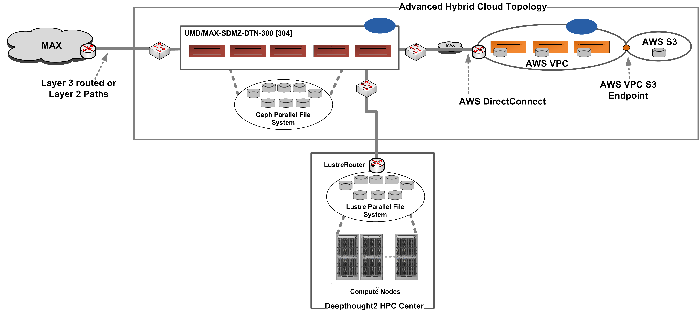
SD-SDMZ Demonstration

Slide 15




SD-SDMZ Demonstration
Advanced Hybrid Cloud Orchestration
AWS
OpenStack
Compute Nodes
Compute Nodes
V-Router
(6)
(2)
Quagga
BGP
Ceph RBD
BGP
VM-y-2
(2)
VM-x-1
VM-y-1
SR-IOV
Profile-2
SR-IOV
Profile-3
………
SR-IOV
Profile-1
(4)
VM-x-m
(5)
VM-y-k
Ceph RBD
VPC
Direct
Connect
SDN
UCS
Fabric
subnet
vgw
VTN
(7)
subnet
(1)
VLAN
(3)
(1)

Slide 16
SD-SDMZ Demonstration
Advanced Hybrid Cloud
SD-SDMZ Demonstration Video:
  https://www.youtube.com/watch?v=osfRJhWHakA
See us for an individual demonstration

Slide 17
Thanks

Slide 18
Example SD-SDMZ Use Cases
Global Land Cover Facility (GLCF)
  Hybrid cloud topology to facilitate data download from R&E and AWS S3 locations to local HPC filesystem
Pan-STARRS Astronomy
  Local compute/storage resources to facilitate download and inline processing of telescope data
Large Scale Geosimulation
  Hybrid cloud topology to facilitate Hadoop cluster set up with local nodes and scalable bursting in to AWS

