Slide 1










SENSE: SDN for End-to-end Networked Science at the Exascale
SC2017
The International Conference for High Performance Computing, Networking, Storage and Analysis
November 12-17, 2017
Denver, Colorado
SENSE Team
Sponsor
Advanced Scientific Computing Research (ASCR)

Slide 2
SENSE Team
ESnet
  Inder Monga
  Chin Guok
  John MacAuley
Fermilab
  Phil Demar
ANL
  Linda Winkler
NERSC
  Damian Hazen
Caltech
  Harvey Newman
  Justas Balcas
  Maria Spiropulu
University of Maryland/Mid-Atlantic Crossroads
  Tom Lehman
  Xi Yang

Slide 3
What Research Problem(s) are We Solving?
Distributed scientific workflows need end-to-end automation so the focus can be on science, and not infrastructure
  Manual provisioning and infrastructure debugging
  takes time
  No service consistency across domains
  No service visibility or automated troubleshooting across domains
  Lack of realtime information from domains impedes development of intelligent services

Slide 4
What Research Problem(s) are We Solving?
Science application workflows need to drive network service provisioning
  Network programming APIs usually not intuitive and require detailed network knowledge, some not pre-known
  Detailed network information needed, usually not easily available
  Efficient use of resources
Multi-domain orchestration requires service visibility and troubleshooting
  Data APIs across domains for applications, users, network administrators
  Performance, service statistics, topology, capability, etc.
  Exchange of ‘scoped’ and authorized information

Slide 5
Vision and Objectives
A new paradigm for Application to Network Interactions
Intent Based – Abstract requests and questions in the context of the application objectives.
Interactive – what is possible? what is recommended? let’s negotiate.
Real-time – resource availability, provisioning options, service status, troubleshooting.
End-to-End – multi-domain networks, end sites, and the network stack inside the end systems.
Full Service Lifecycle Interactions – continuous conversation between application and network for the service duration.

Slide 6
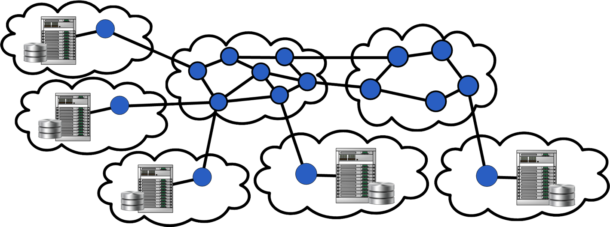
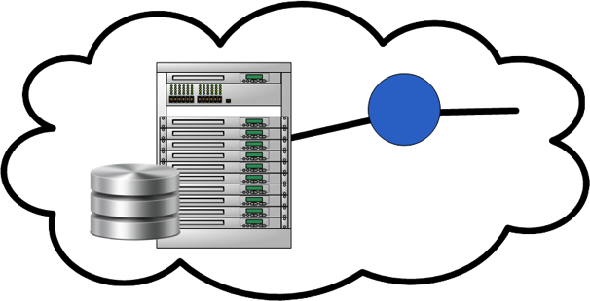
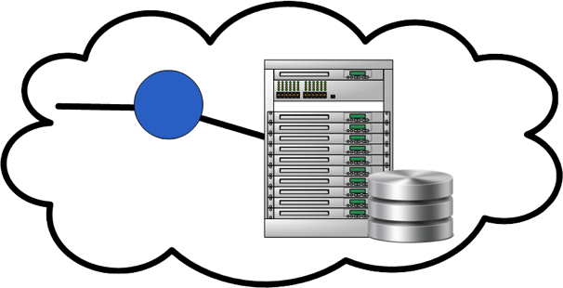



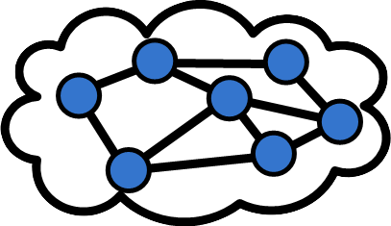
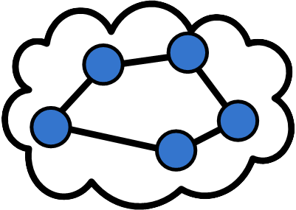


SENSE
Architecture
Application Workflow Agent
Model Driven SDN Control with Orchestration
Intent Based APIs with Resource Discovery, Negotiation, Service Lifecycle Monitoring/Troubleshooting
SENSE End-to-End Model
Datafication of cyberinfrastructure to enable intelligent services
SENSE Orchestrator
Realtime system based on Resource Manager developed infrastructure and service models
RM
RM
RM
DTN
[200G]
DTN
[40G]
DTN
[40G]
RM
UMD
RM
RM
RM
ESnet
MAX
DTN
[50G]
DTN
[200G]
RM
SENSE Resource Manager

Slide 7
SENSE Orchestrator API
Application Workflow Agent
Resource Discovery Service
  Service Discovery
  End-Point Listing
Connectivity Service
  Point-to-Point
  Multi-Point
Resource Computation Service
Monitoring and Troubleshooting Service
Types of Interactions
What is possible?
What is recommended?
Requests with negotiation
Service status and troubleshooting
SENSE Orchestrator
RM
RM
RM
RM
UMD
DTN
[200G]
DTN
[40G]
DTN
[40G]
DTN
[50G]
RM
RM
RM
MAX
ESnet
DTN
[200G]

Slide 8
SENSE Resource Manager API
Model Based Control and Orchestration
SENSE Orchestrator
Allow the machines to automate, iterate, react, and adjust to find solutions and not bring the humans in until absolutely necessary
Control
Learn system states
Read/Sync data
Network Markup Language/RDF based Model Schema
Change system states
Write / Sync data
Multi-Resource Modeling
Feedback /
Awareness
Automatic
Operation
Infrastructure
RM
RM
RM
RM
UMD
DTN
[200G]
DTN
[40G]
DTN
[40G]
DTN
[50G]
RM
RM
RM
MAX
ESnet
DTN
[200G]
SENSE Resource Manager

Slide 9
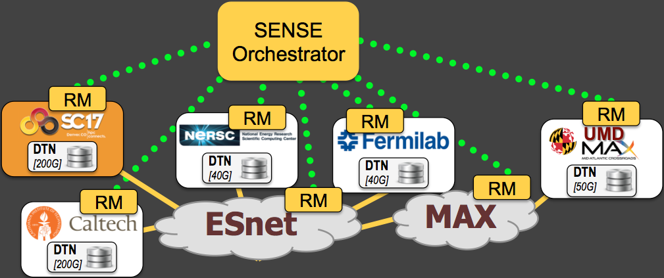
Application to SENSE Interactions
Application Workflow Agent
Please provide a listing of all available provisioning Endpoints
What is the maximum bandwidth available for a P2P service between Caltech and Fermilab?
Please provide a listing of all available provisioning Endpoints
Request 20 Gbps P2P service between Caltech and Fermilab. If 20 Gbps not available 10Gbps is ok.
Service is not working, please check status
Endpoint Listing
What is the maximum bandwidth available for a P2P service between Caltech and Fermilab?
20 Gbps available for a P2P service between Caltech and Fermilab
Request 20 Gbps P2P service between Caltech and Fermilab. If 20 Gbps not available 10Gbps is ok.
15 Gbps P2P service between Caltech and Fermilab Instantiated
Failure on a network element, problem fixed
15 Gbps P2P service between Caltech and Fermilab Instantiated
20 Gbps available for a P2P service between Caltech and Fermilab
Endpoint Listing
Service is not working, please check status
Failure on a network element, problem fixed

Slide 10
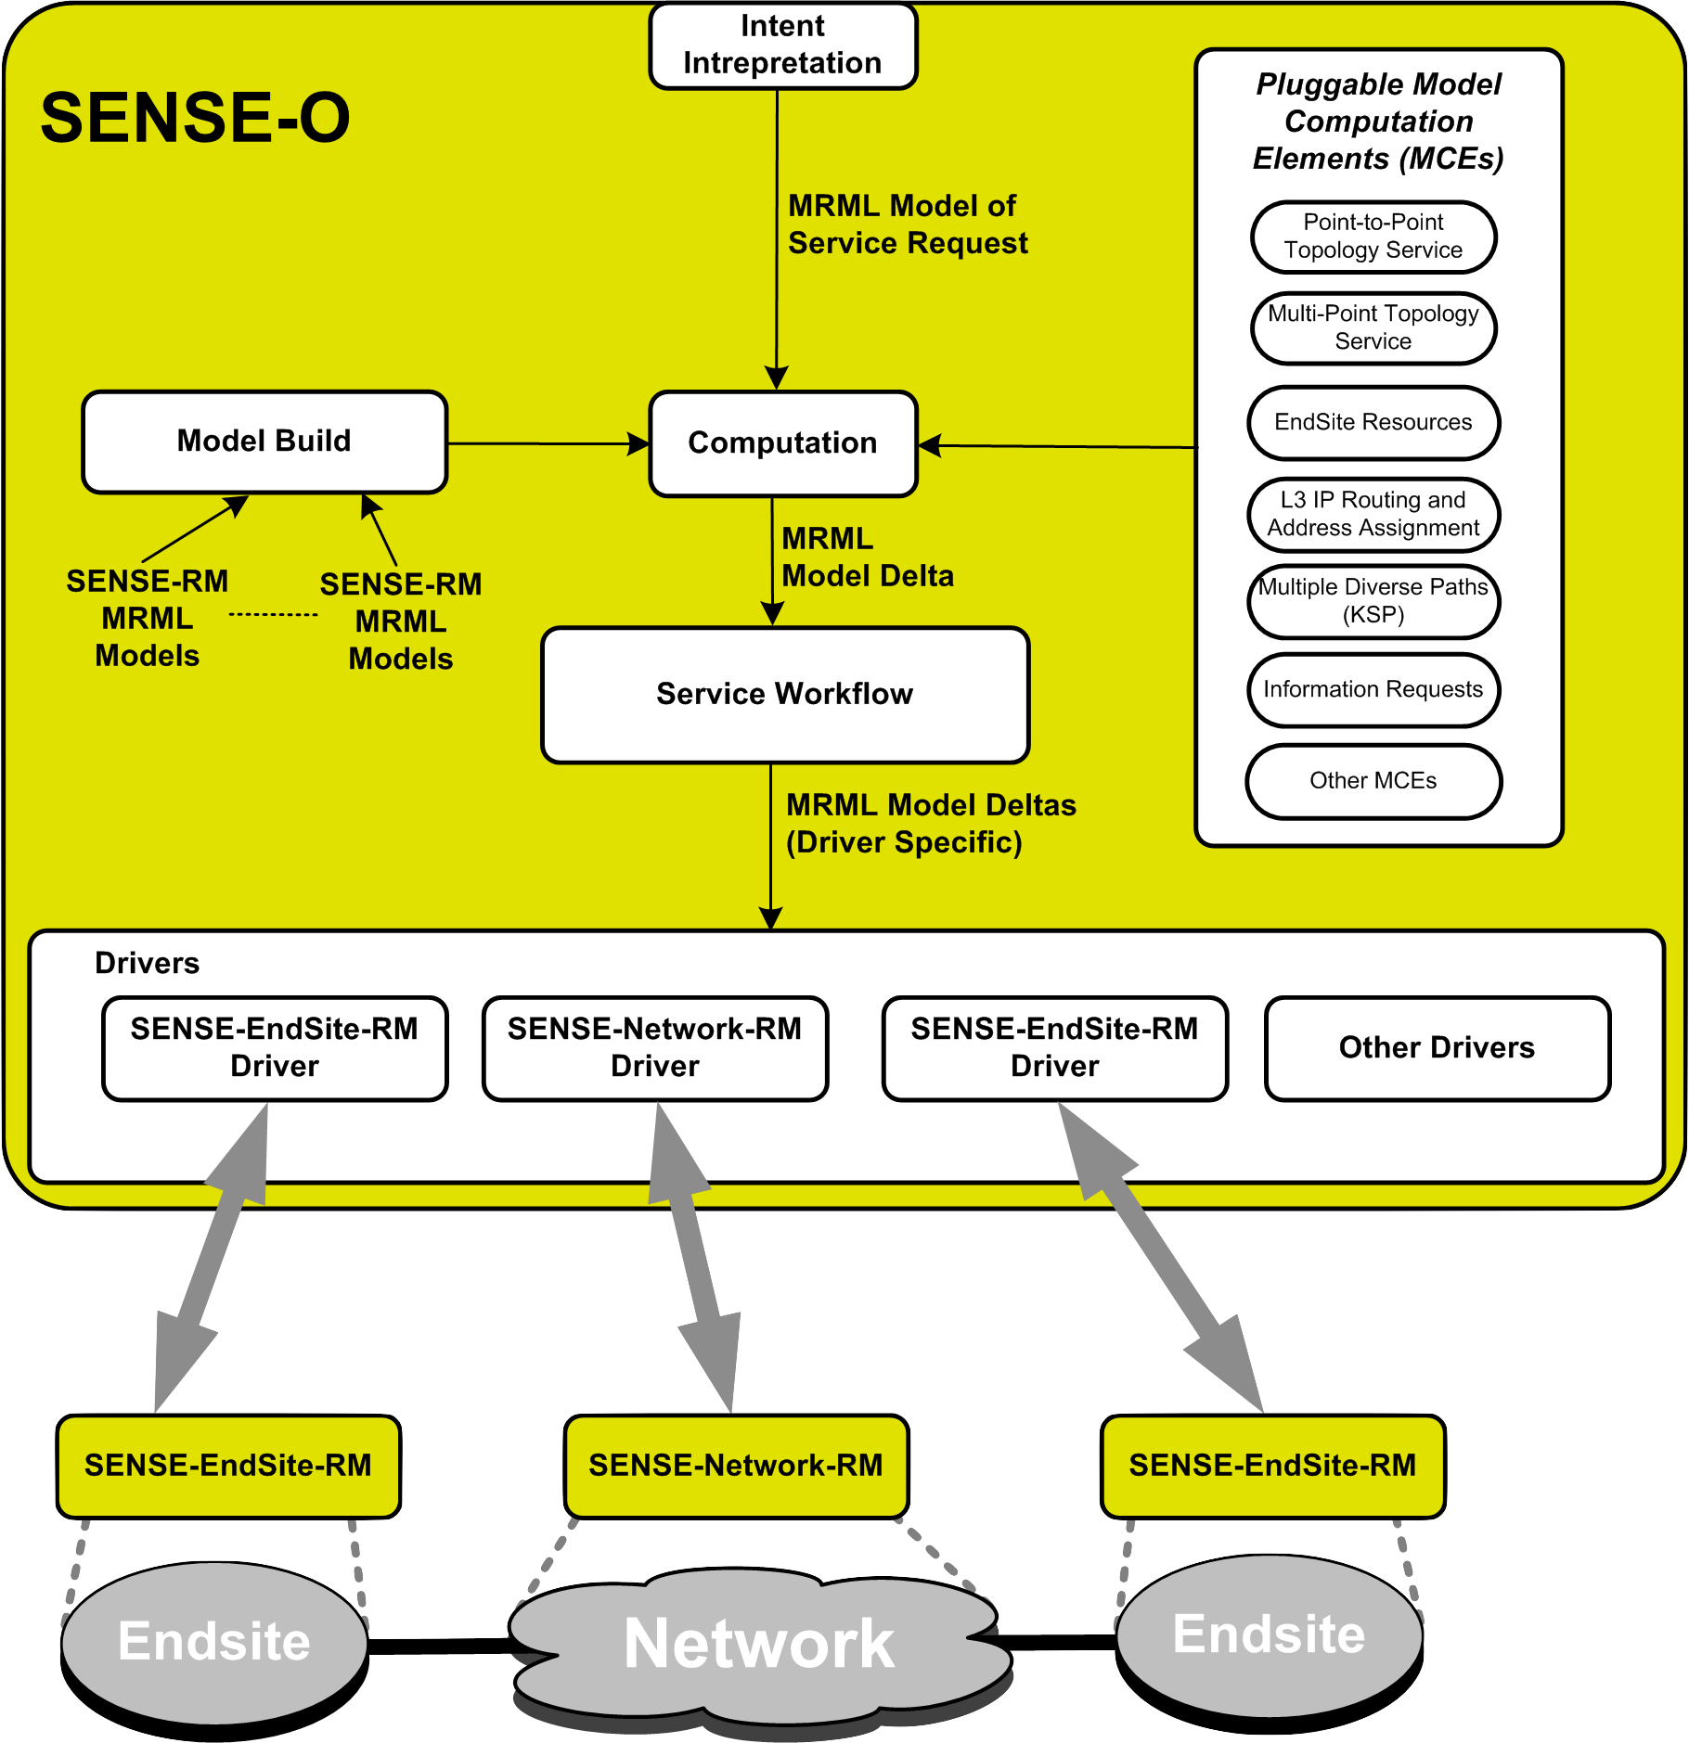
SENSE Orchestrator and Services
Application Workflow Agent
Data Plane Connectivity Services:
Point-to-Point
Multi-Point
Options
Layer 2
Layer 3 Addressing (on top of Layer 2)
Layer 3 Routed Network Connections
Quality of Service
Scheduling
Preemption
Strict and Loose hops
Negotiation
Batch Service Request
Lifecycle monitoring and debug
SENSE-O is based on StackV open source model driven orchestration system:
github.com/MAX-UMD/stackV.community

Slide 11
SENSE Network Resource Manager (RM)
SENSE-O
Network-RM Functions/Roles:
Responsible for a specific set of Network Resources
Generate realtime MRML Model
Evaluate and respond to SENSE-O information and service requests (including negotiation)
Provision network resources in support of SENSE services
Provide status, monitoring, and debug functions
SENSE-RM API
Model Based Interface
Infrastructure and Services
Network-RM
OSCARS/NSI
SDN Controller
Others
Network
Controller

Slide 12
SENSE DTN/End Site Resource Manager
SENSE-O
EndSite/DTN-RM Functions/Roles:
Responsible for a specific set of EndSite and DTN Resources
Generate realtime MRML Model
Evaluate and respond to SENSE-O information and service requests (including negotiation)
Provision EndSite/DTN resources in support of SENSE services (includes networking stack of end systems)
Provide status, monitoring, and debug functions
QoS provided via OpenFlow (Open vSwitch) flow prioritization and/or TC (FireQoS)
SENSE-RM API
Model Based Interface
Infrastructure and Services
EndSite/DTN
RM
Switch/Router
To
external
network
End-Site/DTN Resources

Slide 13
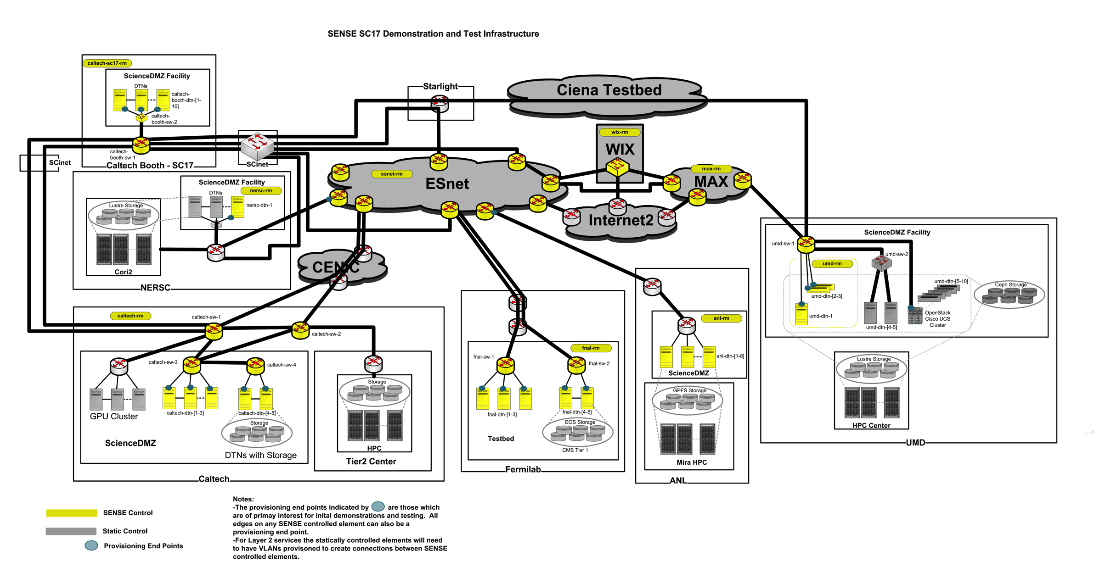
Actual Demonstration Topology is Complex!

Slide 14
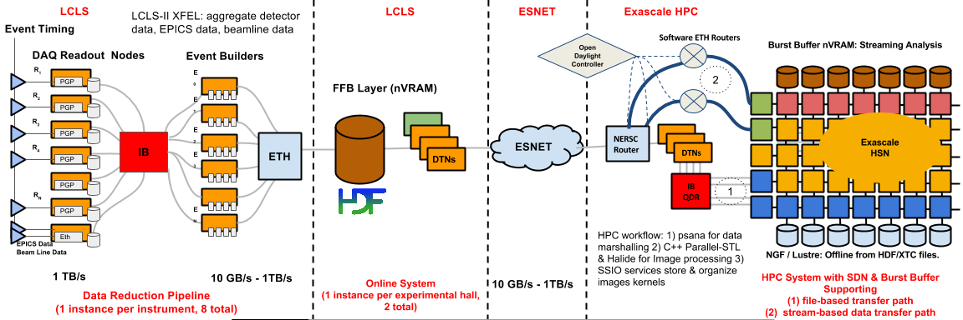
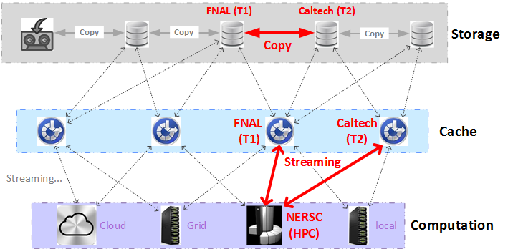
But not as complex as real systems
Initial SENSE Use Cases
LHC, CMS
  13 Tiers 1s, 170 Tier 2s
Superfacility

Slide 15
End to End Provisioning
(see us for a demonstration)
Workflow:
-SENSE-RM provide Resource models to SENSE-O
-SENSE-O builds end-to-end Model
-Batch Provisioning of three P2P connections (UMD/MAX to Caltech-Booth, FNAL to Caltech-Booth, FNAL to Caltech)
-Dataflow between end systems using FDT
SENSE End-to-End Model
SENSE Orchestrator
RM
RM
RM
DTN
[200G]
DTN
[40G]
DTN
[40G]
RM
UMD
RM
RM
RM
ESnet
MAX
DTN
[50G]
DTN
[200G]
RM
SENSE Resource Manager

Slide 16
SENSE Project Status
Start of second year of three year project
Initial versions of the following complete: Network Resource Manager, EndSite/DTN Resource Manager, Orchestrator
Following functions complete: Resource Model Generation and processing, resource computation, abstract service requests, basic layer 2 P2P service instantiation
To do list: negotiation, additional QoS, multi-point, resource computation for more complex services and questions, scheduling, lifecycle services monitoring and troubleshooting, application workflow agent and northbound API, preemption, strict/loose hops, application integration

Slide 17
SENSE
Interesting Research Questions
Tradeoffs between scaling and real-time performance
  How to make this dynamic/configurable to adjust based on conditions and application needs
Which information/states should be routinely exchanged between Resource Manager(s) and Orchestrator? Which information should be accessible on demand?
  How to make this dynamic/configurable to adjust based on different Resource Manager capabilities and policies?
What is the right level of abstraction for Application Agent to SENSE system interactions? Is it necessary to provide a variable levels from highly abstract to very detailed and resource specific?
What is the best method for realizing multi-domain, multi-resource authentication and authorization? What is the proper granularity for this? User? Project? Domain? Individual network and end system resource elements? Flows?

Slide 18
Thanks!

